Slide 1
ENEE150 Discussion #12
Pratik Rathore
4/29/21

Slide 2
Agenda
Project 4

Slide 3
Project 4 – Overview
For this project, you will be implementing a hash table ADT
Functionality:
This ADT will allow for inserting and search for elements in the hash table; it will also let users resize the hash table on-the-fly to improve performance
The ADT will be polymorphic, which will allow the data types stored to be defined by the user
The user will be able to control how elements are printed using function pointers

Slide 4
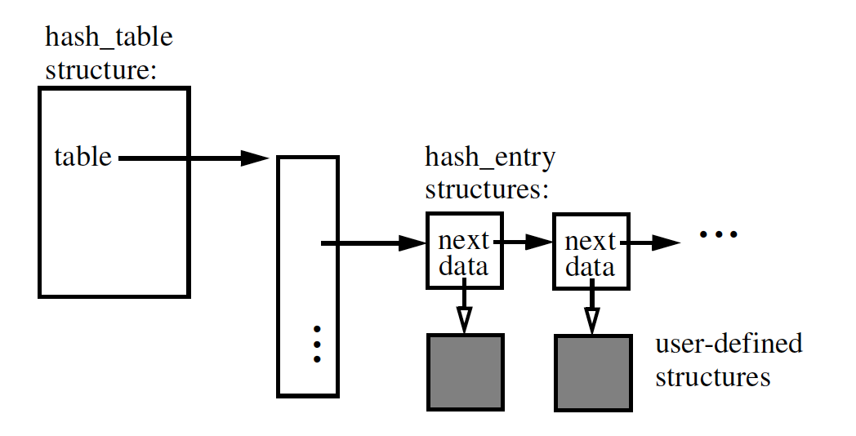
Hash Table – Overall Structure
The hash table will be a struct that contains a pointer to an array of keys (along with several other fields)
The keys will be strings, the hash function will convert them to integers
The linked lists associated with each bucket will not contain the actual data – they will contain generic pointers to user-defined data structures
Array of buckets

Slide 5
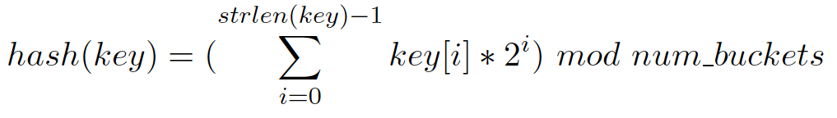
Hash Table Struct + Hash Function
The hash table struct should contain the following fields:
A pointer to a pointer array of linked list heads (hash_entry**)
The number of buckets in the hash table (int)
The total number of elements in the hash table (int)
The total number of searches performed (int)
The total number of data records searched (int)
The max number of data records traversed across all searches (int)
A function pointer to a user-defined printing function
Fields 3 – 6 will be especially useful for the stat_hash function (covered later)
The hash function will convert an input string to an int:
key[i] is the ASCII value of the string at position i, num_buckets is the number of buckets as requested by the user
Use an unsigned int when computing the sum within the hash function to avoid overflow

Slide 6
Hash Entry Struct
The linked list nodes will contain the following fields:
key (char*)
data (void*)
next (hash_entry*)
Remember that we use a generic pointer to the data since we do not know the type of data beforehand

Slide 7
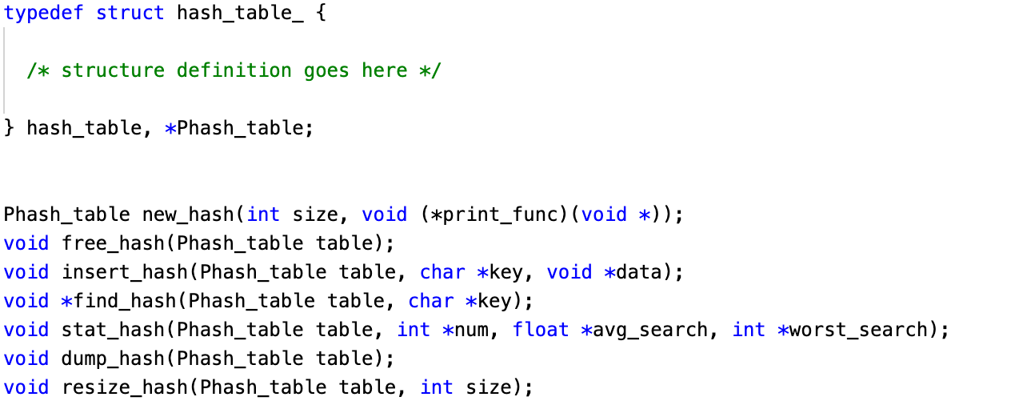
Required Functions
You have been provided with an interface, hash.h, containing seven required functions
new_hash
free_hash
insert_hash
find_hash
stat_hash
dump_hash
resize_hash
The implementation of these seven functions should be done in a file called hash.c
hash.h on ELMS

Slide 8
new_hash
Declaration: Phash_table new_hash(int size, void (*print_func)(void *))
size: Number of buckets in the hash table
print_func: Function pointer to user defined print function
new_hash is the ADT constructor
The function will dynamically allocate a hash table and return a pointer to it
All buckets should be empty, i.e. set to NULL

Slide 9
free_hash
Declaration: void free_hash(Phash_table table)
table: Hash table to be freed from memory
free_hash is the hash table destructor
All structs and arrays that have been dynamically allocated as part of the ADT should be freed
The associated user data should also be freed

Slide 10
insert_hash
Declaration: void insert_hash(Phash_table table, char *key, void *data)
table: Table to insert entry into
key: Entry key
data: Entry data
insert_hash inserts a new hash entry into the table according to the key
Insertion should always be performed at the head to ensure that your program outputs match the test vectors

Slide 11
find_hash
Declaration: void *find_hash(Phash_table table, char *key)
table: Hash table to search
key: Key to look for in hash table
find_hash will look for an entry corresponding to the key
The function will either return a pointer to the user-defined data record found during the search, or it will return NULL if the record is not found

Slide 12
stat_hash
Declaration: void stat_hash(Phash_table table, int *total, float *average_search, int *worst_search)
table: Hash table to extract statistics from
total, average_search, worst_search: Variables to which statistics should be assigned (pass-by-reference)
stat_hash will use the hash table fields to return the total entries, average records searched, and largest number of records searched
There is no return argument since these three values will be assigned using the references provided by the user

Slide 13
dump_hash
Declaration: void dump_hash(Phash_table table)
table: Table to be printed
Print the hash table using the user defined print function
Printing should be done from the first to last bucket
Within buckets, printing should be done from the head to tail of the linked list

Slide 14
resize_hash
Declaration: void resize_hash(Phash_table table, int size)
table: Table to be resized
size: Number of buckets in the resized hash table
resize_hash will resize the hash table to the number of buckets specified by the user
The easiest way to perform resizing is to create a new pointer array for the buckets, and then reinsert the hash table entries based on the hash function
resize_hash should also clear all the fields associated with the performance statistics returned in stat_hash (i.e. fields 3 – 6)

Slide 15
Applications
After creating your hash table ADT, you will test it out using parse.c (you will have to make some modifications to the file on ELMS) and performance-test.c (file on ELMS)
See the project handout for more details

Slide 16

Tips
As always, start early
Ask questions at office hours and email questions to TAs/Dr. Yeung
There is no main function for the ADT – only functions that perform ADT operations
You can add new functions/structs to hash.h, just don’t delete anything from the original
Keep up the great work, there are just two weeks left of classes!

Slide 17
Questions?

